Slide 1

MACHINE LEARNING PROJECT
CARVAL-PREDICTOR
Used Car Price Prediction Using Machine Learning
TEAM MEMBERS:
Santhosh Mavuri,24EU01102
K Bhuvana Venkata Sai,24EU01089
Akshith Muni .K,24EU01130

Slide 2

Problem Statement
Estimating a fair used-car price is difficult: there is no single formula for resale value
Price varies with year, kilometres driven, fuel type, seller type, transmission and owner history
Manual estimates are subjective and can differ from buyer to seller
A data-driven model learns price patterns from 4,340 past records
Machine learning (regression) turns car details into an estimated selling price
Car details
Brand · Model · Year · KM driven · Fuel · Seller type · Transmission · Owner
▼
ML regression model
▼
Estimated selling price

Slide 3
Dataset & Data Source
4,340
9
8
1
Column | Type | Role
Brand | text | Feature
Model | text | Feature
Year | int64 | Feature
KM_Driven | int64 | Feature
Fuel | text | Feature
Seller_Type | text | Feature
Transmission | text | Feature
Owner | text | Feature
Selling_Price | int64 | Target
rows
columns
input features
target: Selling_Price
Dataset file: Car Price.csv
Data source: DATASET
Missing values: 0 in all columns
Year range: 1992 – 2020
Selling_Price: min 20,000 · median 350,000 · mean 504,127 · max 8,900,000
KM_Driven: min 1 · median 60,000 · max 806,599
Notes:
Source: the notebook only loads ../Dataset/Car Price.csv and does not name an origin, so it is marked as not available.

Slide 4
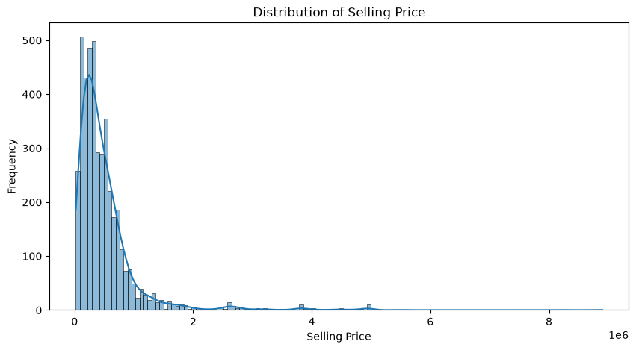
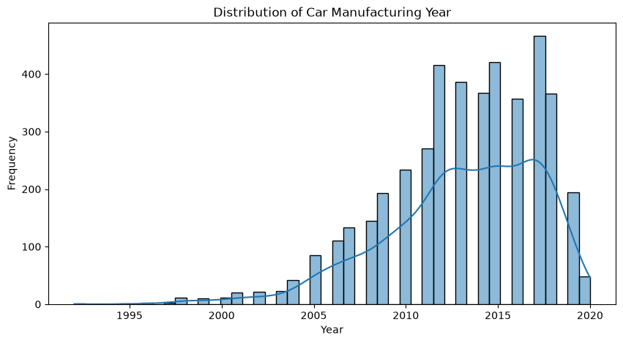
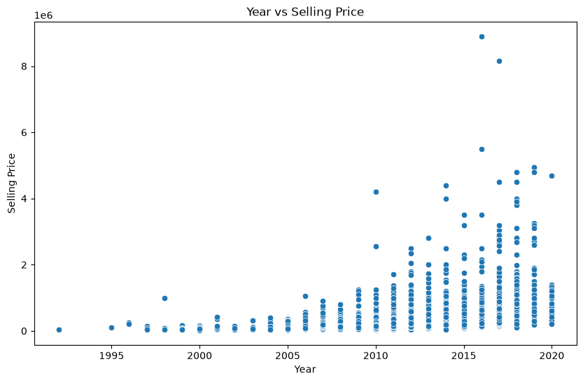
Exploratory Data Analysis
Distribution of Selling Price
Distribution of Manufacturing Year
Year vs Selling Price
Price is right-skewed
Newer cars dominate
Year drives price range
Most cars sit at lower prices; a long tail reaches up to 8,900,000.
Most listings are from roughly 2010 to 2019; older cars are fewer.
Higher prices appear mainly for newer cars; older cars stay at low prices.
Notes:
All three plots are the original notebook outputs (seaborn / matplotlib).

Slide 5
Data Preprocessing
1
2
3
4
5
Raw dataset
Cleaning checks
One-hot encoding
Train/test split
Scaling
4,340 rows × 9 columns loaded from CSV
›
0 missing values; 763 duplicate rows detected
›
6 categorical columns, drop_first=True: 8 → 1,531 features
›
80% / 20%, random_state=42: 3,472 train, 868 test
›
StandardScaler fitted on train; used for Linear Regression
763 duplicate rows removed
No missing values — imputation not required
Notes:
Duplicates: 763 detected by df.duplicated().sum() but never dropped in the notebook. Scaling is fitted on the training split only.

Slide 6
Feature Engineering / Selection
Input features (8)
TARGET
Year
KM_Driven
Brand
Model
Fuel
Selling_Price
→
Seller_Type
Transmission
Owner
predicted price of the used car
Engineered features: none.
Features removed: none (only the target was separated from X)
One-hot encoding expands the 8 inputs into 1,531 model features
Year vs Selling Price scatter shows newer cars reach higher prices (EDA)
Feature-importance results: Not available in notebook

Slide 7



Machine Learning Models Used
Linear Regression
Decision Tree Regressor
Random Forest Regressor
Fits a linear relationship between the features and price.
Splits the data with learned rules to predict price.
Averages many decision trees for a more stable prediction.
Trained on StandardScaler-scaled features
random_state=42, other settings default
n_estimators=100, random_state=42
The best of these, Random Forest, was then tuned with GridSearchCV (slide 10). Only these three model types were trained.

Slide 8
Training & Evaluation Workflow
1
2
3
4
5
6
7
Dataset
Preprocess
Split
Training
Prediction
Evaluation
Selection
›
›
›
›
›
›
Car Price.csv
One-hot encoding
80% / 20%
LR, DT, RF
868 test rows
MAE, MSE, RMSE, R²
Best metrics wins
Metrics calculated in the notebook
MAE
MSE
RMSE
R² Score

Slide 9
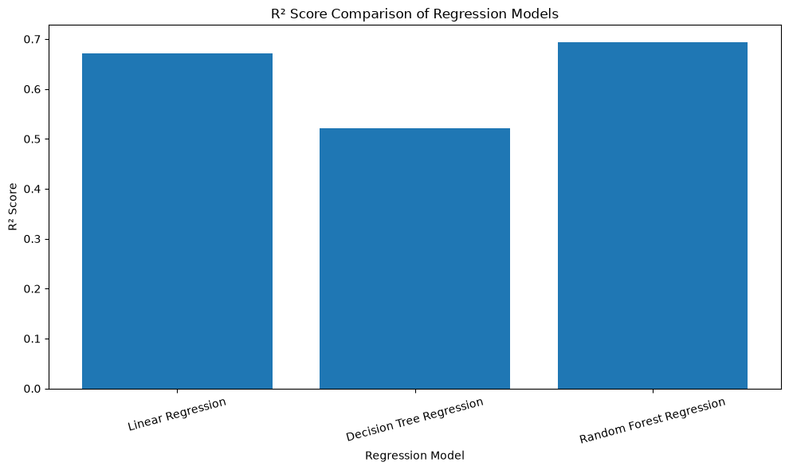
Model Comparison
Model | R² Score | MAE | RMSE
Linear Regression | 0.670598 | 105972.796389 | 317054.903530
Decision Tree Regression | 0.521965 | 115805.743664 | 381945.047990
Random Forest Regression | 0.693497 | 101082.895292 | 305835.890885
R² comparison
0.693497
101082.90
Lower MAE/RMSE and higher R² are better. Linear Regression is second; Decision Tree is weakest.
Best R² before tuning: Random Forest
Lowest MAE: Random Forest
Notes:
Values are copied from the notebook results table (cell 19). Random Forest is best before tuning on every metric.

Slide 10
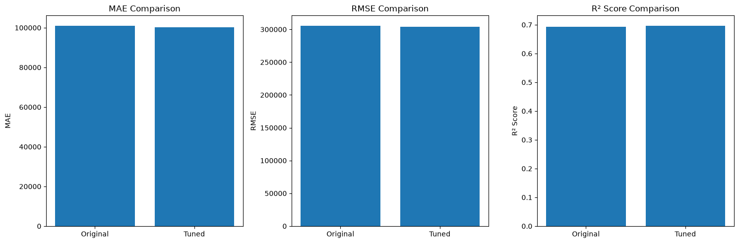
Hyperparameter Tuning
Model tuned: Random Forest Regressor
Method: GridSearchCV, cv=3, scoring R²
Parameters tested:
n_estimators [100, 200]
max_depth [None, 10, 20]
min_samples_split [2, 5]
Best: n_estimators=200, max_depth=None, min_samples_split=2
Metric | Before | After tuning
R² Score | 0.693497 | 0.697233
MAE | 101082.895292 | 100274.741592
RMSE | 305835.890885 | 303966.175555
Best CV R² during grid search: 0.790315
Tuned model selected because it is better on all three metrics. The gain is small (R² +0.0037).
original vs tuned Random Forest
Notes:
Tuning improved all three metrics slightly. The notebook comment states Tuned Random Forest is the best model.

Slide 11
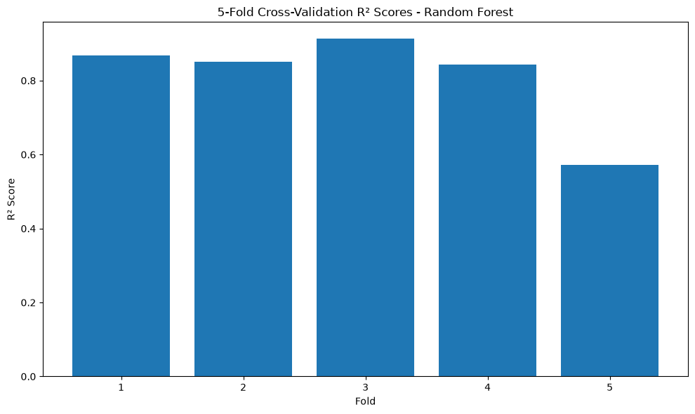
Final Model & Results
Final model: Tuned Random Forest Regression
0.6972
100,274.74
303,966.18
R² (test set)
MAE
RMSE
Why this model was selected
Highest R² of all models trained (0.697233)
Lowest MAE and RMSE of all models
Improved over the untuned Random Forest
Notebook output: 5-fold R² (Random Forest)
Mean R²: 0.809345
Notes:
Cross-validation (5-fold, original RF, full dataset) averages 0.8093 but fold 5 is only 0.5715, so performance varies by data subset. Test-set R² is 0.6972.

Slide 12
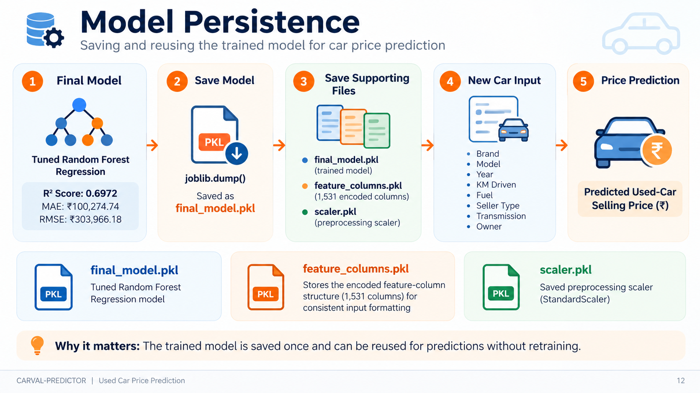

Slide 13
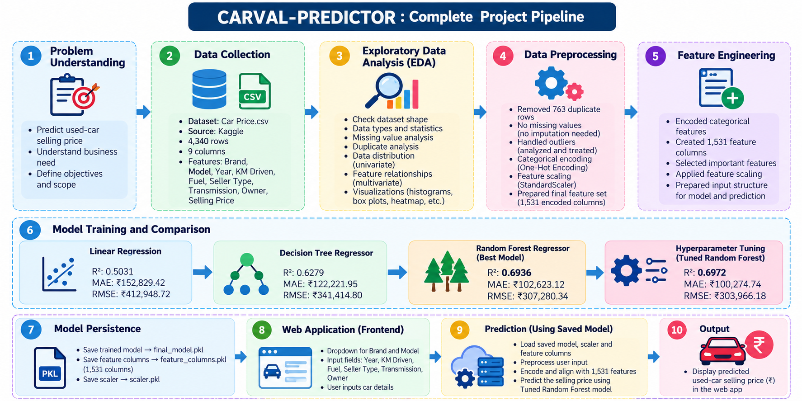

Slide 14
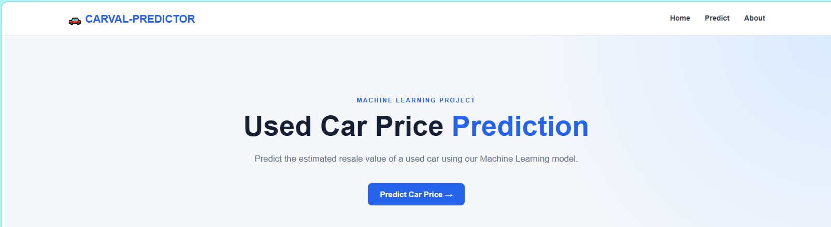
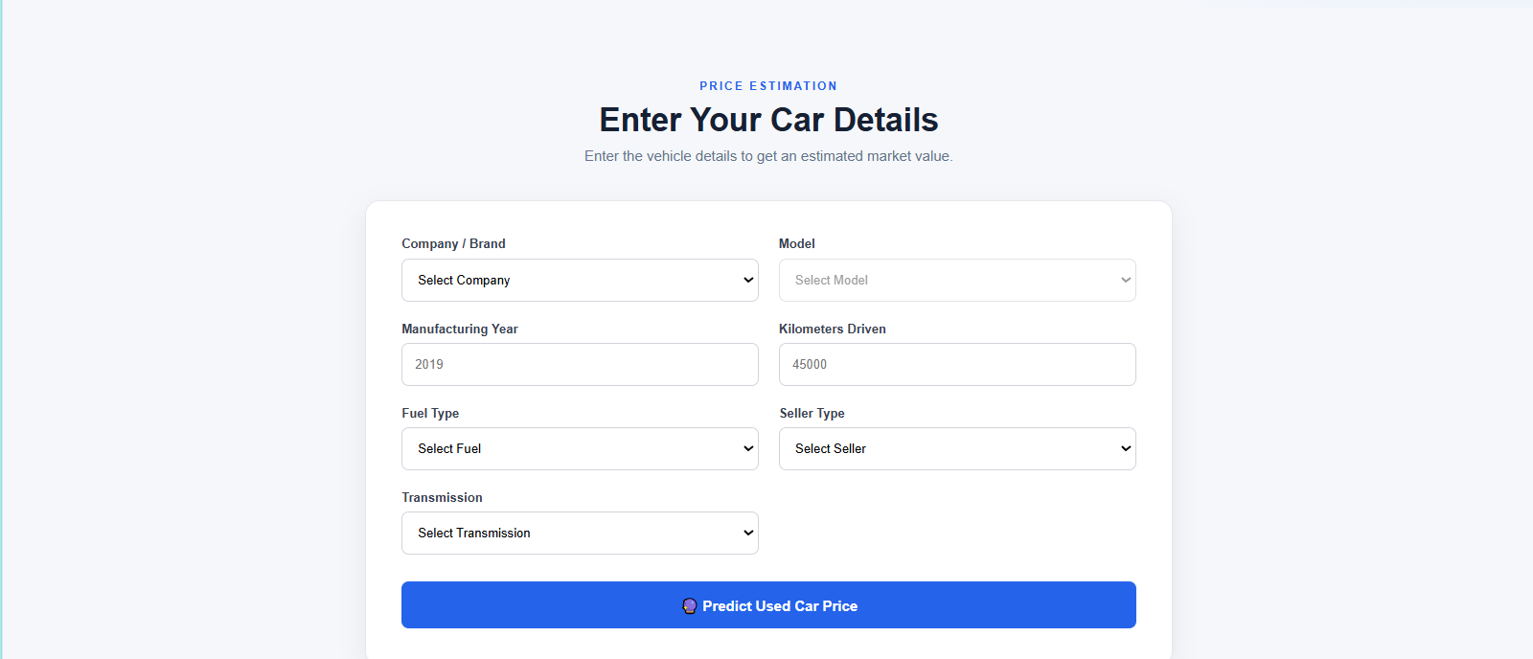
Demonstration
Notes:
No screenshots exist in the repository, so this is a mockup built from the real form fields in Frontend/index.html. No predicted price is shown because none was provided.

Slide 15
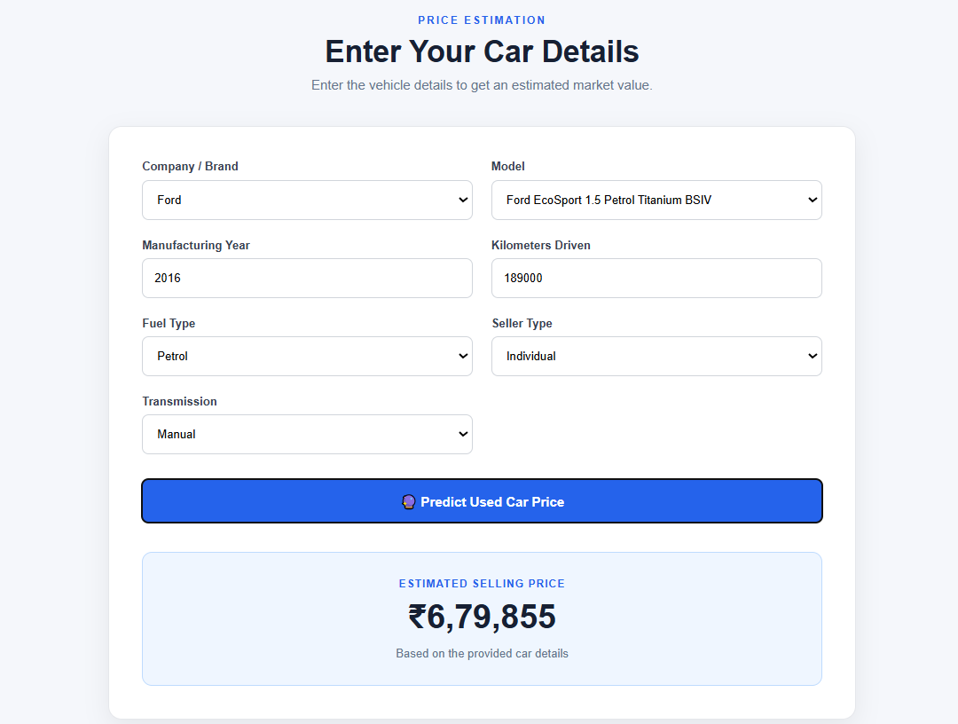
TESTING:

Slide 16





Real-World Applications
Used-car buyers
Car sellers
Dealers
Check whether an asking price looks reasonable.
Set a realistic listing price from car details.
Quote trade-in and resale prices consistently.
🏦
Resellers
Financial Institutions
Negotiation & valuation
Spot cars priced below their estimated value.
Estimate car values for loan and financing decisions.
Give both sides a data-backed reference point.

Slide 17
Conclusion & Future Scope
Conclusion
Future scope
Problem: estimate used-car prices from vehicle details
Approach: one-hot encoding with Linear Regression, Decision Tree and Random Forest
Best model: Tuned Random Forest
Final test results:
R² 0.6972
MAE 100,274.74
RMSE 303,966.18
Ideas only, not completed work
Larger, more diverse dataset
More vehicle features
Advanced ensemble models
Broader hyperparameter search
Real-time market data
Improved web deployment

Slide 18


